Slide 1
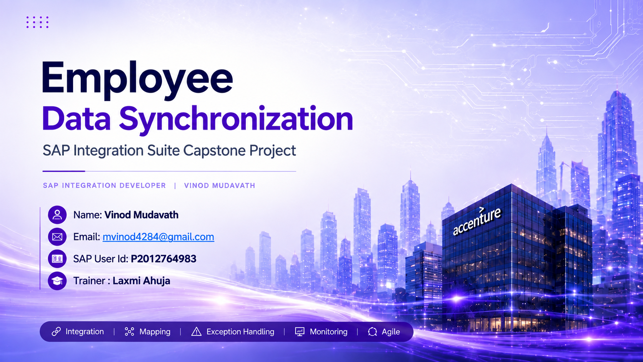

Slide 2
Executive Summary
A single consolidated iFlow implements the end-to-end capstone requirement.
01 Integrate
SuccessFactors employee data is fetched through OData and transformed for S/4HANA.
02 Synchronize
Employee master data is posted to the S/4HANA On-Premise OData service.
03 Distribute
S/4HANA data is converted to CSV and delivered to the SFTP payroll directory.
04 Control
Exception Subprocess catches failures and prepares administrator notification.
05 Monitor
CPI monitoring, trace, messages and deployment status support validation.
Employee Data Synchronization | SAP Integration Suite Capstone
2

Slide 3
Project Objective & Business Scenario
Project Objective
Automate employee data synchronization using SAP Cloud Integration, connecting SuccessFactors, S/4HANA, SFTP, and Mail. Transform employee data, generate payroll CSV files, and send failure notifications to administrators.
Business Scenario
HR source: SAP SuccessFactors.
Core integration: SAP Cloud Integration.
Finance/master-data target: SAP S/4HANA On-Premise.
Payroll handoff: SFTP directory AEH.
Failure path: Mail notification to the administrator.
Employee Data Synchronization | SAP Integration Suite Capstone
3

Slide 4
System Landscape
The solution connects four business-facing systems through SAP Cloud Integration.
SuccessFactors
HR employee master data
SAP Cloud Integration
Orchestration • Mapping • Routing
S/4HANA On-Premise
Employee data / OData
SFTP Server
Payroll CSV exchange
Mail
Exception notification
SuccessFactors Credential
SFCred_Laxmi
S/4HANA OData Credential
L4C_Cred
SFTP
Personal account
Mail
Personal account
Employee Data Synchronization | SAP Integration Suite Capstone
4

Slide 5
Consolidated iFlow Architecture
One deployed iFlow combines employee synchronization, payroll delivery and exception handling.
Integration Process
SuccessFactors
OData V2
S/4HANA
OData
Start Timer 1
Fetch / Request
Transform
Post to S/4
CSV Convert
SFTP Delivery
End
Exception Subprocess
Error Start → Content Modifier → Error End → Mail notification
Gmail / Mail
Admin notification
Employee Data Synchronization | SAP Integration Suite Capstone
5

Slide 6
End-to-End Processing Flow
Business sequence implemented in the completed iFlow.
1
2
3
4
5
6
7
Timer
Starts scheduled processing
SuccessFactors
Reads employee records
Mapping
Creates target employee structure
S/4HANA
Posts transformed employee data
CSV
Converts employee data to CSV
SFTP
Transfers payroll-ready file
Mail
Notifies admin on failure
Control Point
If any processing step fails, the Exception Subprocess captures the error and routes an email notification.
Employee Data Synchronization | SAP Integration Suite Capstone
6

Slide 7
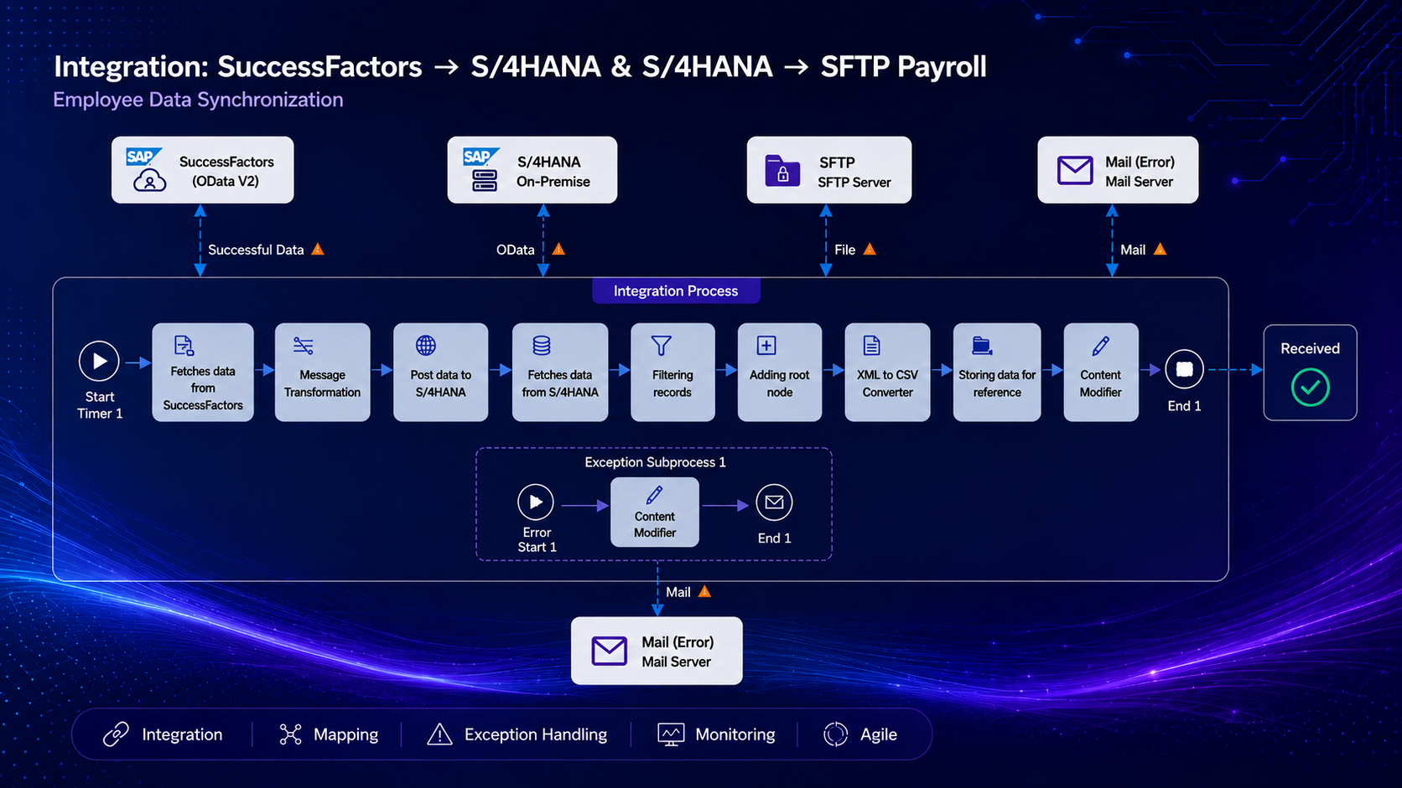

Slide 8
Message Mapping — SuccessFactors to S/4HANA
Mapping logic follows the assessment specification.
Target Field | Source Field | Mapping Logic | Requirement
Mandt | — | Hardcode 500 | Static SAP client
Participantid | firstName + lastName | Concatenate with space | Required
Country | country | Direct mapping | Uppercase if required
Sfempname | firstName + lastName | Concatenate with space | Same as Participantid
City | city | Direct mapping | From SuccessFactors
Example
Erik + Hansen → Participantid = “Erik Hansen” | Mandt = “500” | Country and City copied from source
Employee Data Synchronization | SAP Integration Suite Capstone
8

Slide 9
Exception Handling & Reprocessing
Failure notifications are isolated from the main business path.
Error Start
Any message-processing exception enters the Exception Subprocess.
Content Modifier
Builds the administrator notification payload using error/context information.
Mail Adapter
Sends the notification through the configured personal Gmail/SMTP setup.
Operational Benefit
The main flow remains focused on business processing while failures become visible, actionable and easier to troubleshoot.
Employee Data Synchronization | SAP Integration Suite Capstone
10

Slide 10
Connectivity & Security
Credential artifacts are referenced by the iFlow instead of embedding passwords.
SuccessFactors
Credential artifact: SFCred_Laxmi
Adapter: OData V2
Purpose: Read employee master data
S/4HANA
Credential artifact: L4C_Cred
Adapter: OData
Purpose: Post/read employee data
SFTP + Mail
SFTP: personal training account
Mail: personal account
Purpose: payroll file exchange + error notification
SECURE ARTIFACTS
NO PASSWORDS
SEPARATION OF DUTIES
Employee Data Synchronization | SAP Integration Suite Capstone
11

Slide 11
SDLC & Agile Scrum Implementation
The capstone is presented as an iterative delivery lifecycle.
1
Requirement Analysis
Business scenario, fields, systems
2
Design
Landscape, iFlow, mapping, exception path
3
Development
Adapters, mappings, converters, mail
4
Testing
Positive + negative scenarios
5
Deployment
Deploy and validate runtime
6
Maintenance
Monitor, troubleshoot, improve
Agile Artifacts
Product Backlog • Sprint Backlog • Burndown • Sprint Review • Retrospective
Employee Data Synchronization | SAP Integration Suite Capstone
14

Slide 12
Conclusion
A production-style integration pattern automates employee synchronization and payroll delivery.
AUTOMATED
Employee synchronization from SuccessFactors to S/4HANA reduces manual effort and improves consistency.
CONTROLLED
Exception handling, monitoring and notifications provide operational visibility.
CONNECTED
Payroll-ready CSV delivery through SFTP completes the downstream integration.
SAP CLOUD INTEGRATION
HR ↔ Finance ↔ Payroll
INTEGRATION
MONITORING
AGILE
Employee Data Synchronization | SAP Integration Suite Capstone
17

Slide 13
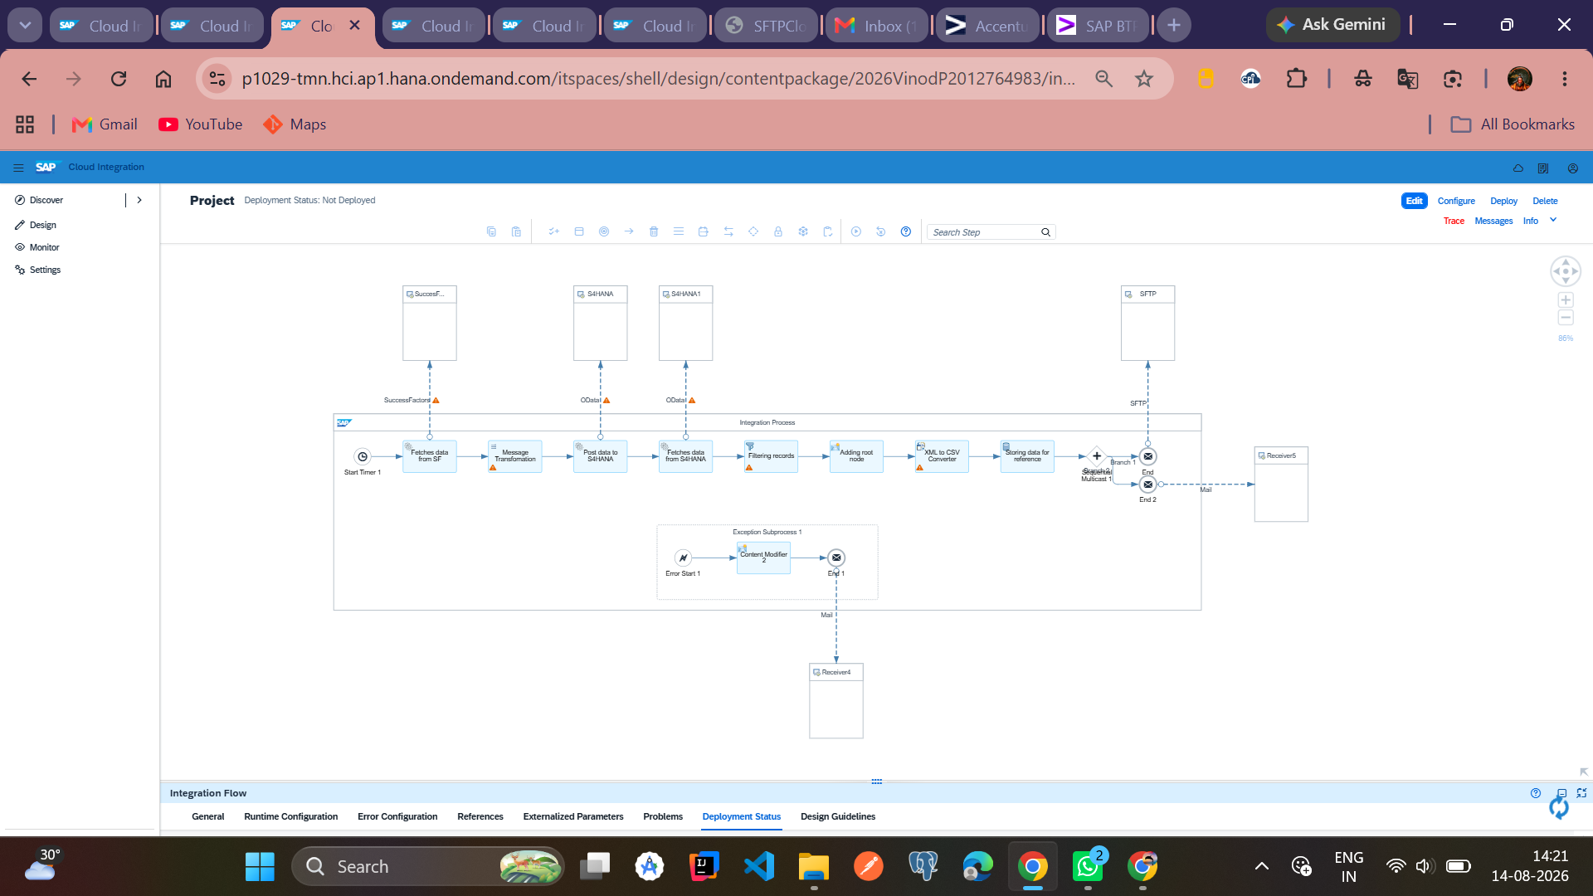

Slide 14
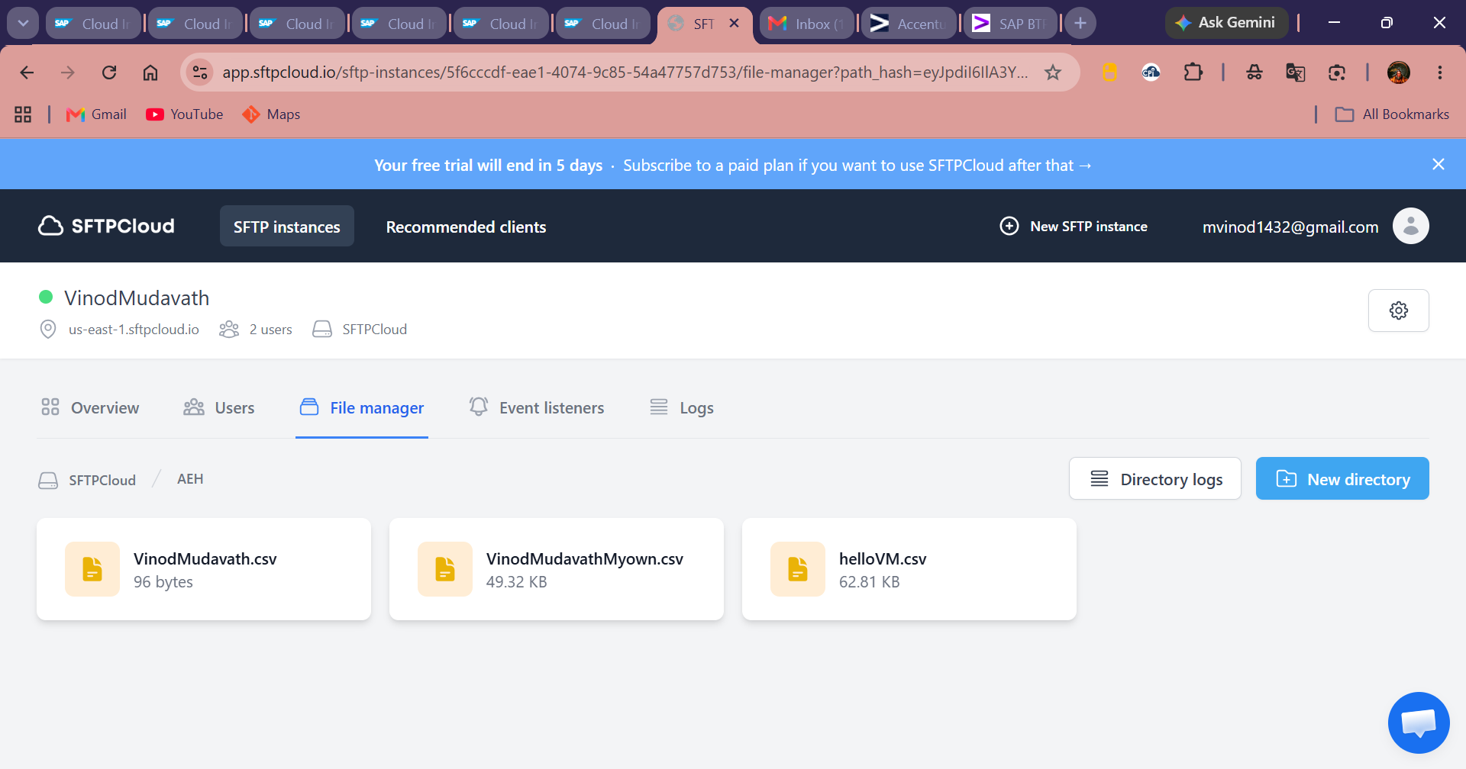

Slide 15
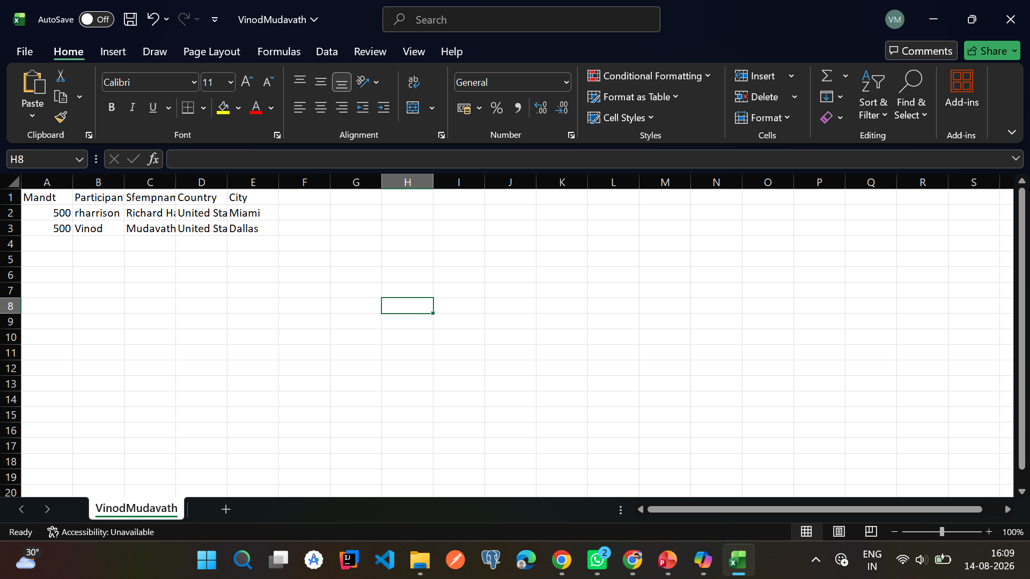

Slide 16
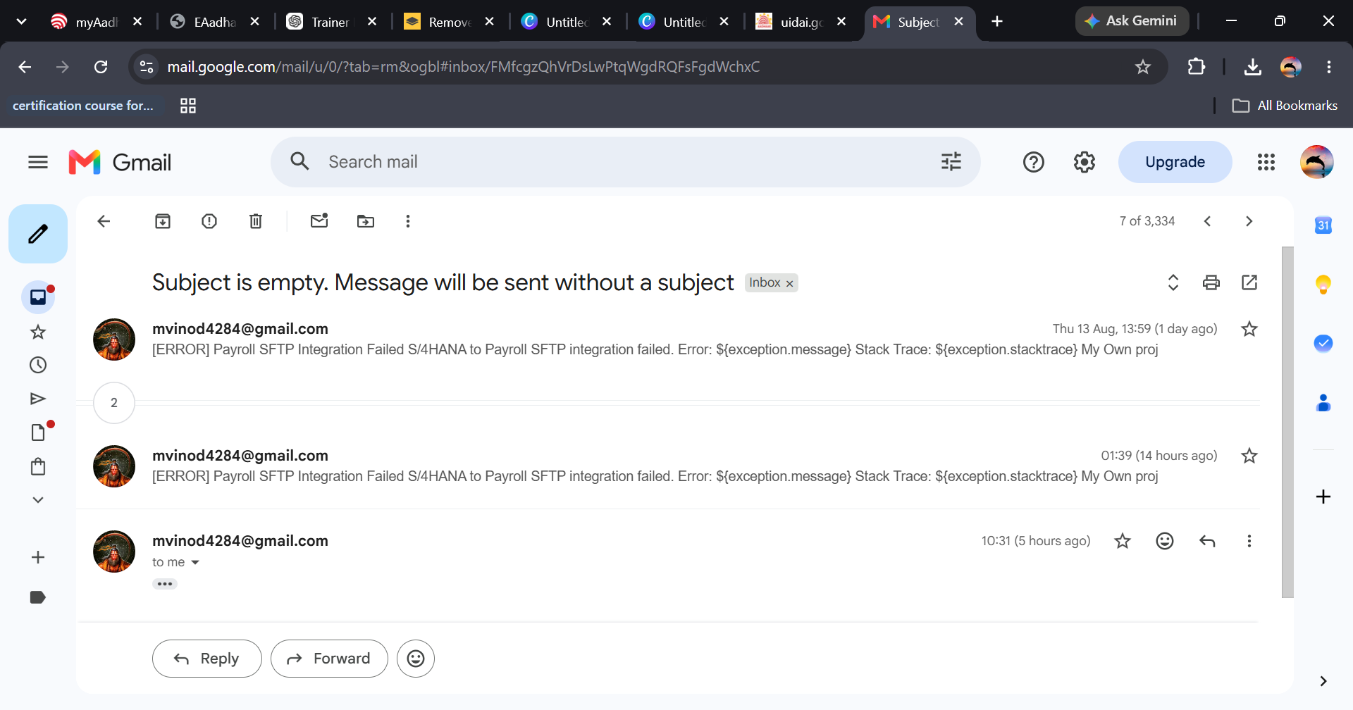

Slide 17
THANK YOU
SAP CLOUD INTEGRATION
End-to-End Integration
Questions & Demo
SUCCESSFACTORS
HR
S/4HANA
Finance
Employee Data Synchronization
SAP Integration Suite Capstone Project
Vinod Mudavath | SAP Integration Developer
SFTP
Payroll
INTEGRATION
MAPPING
EXCEPTION
MONITORING
AGILE
Employee Data Synchronization | SAP Integration Suite Capstone
18

